Slide 1
Course Orientation

Slide 2
Course Information
강좌 개요
강좌 명: 데이터과학개론
담당 교수: 김 남 규 (ngkim@kookmin.ac.kr, 경영관 306호, 02-910-5425)
수업 진행: youtube + Zoom(화요일 19:00 ~ )
수업 평가: 기말고사 80%, Quiz: 20%
강좌 소개
수업 목표
데이터 과학을 배우기 위해 필요한 기본 개념, 주요 용어, 핵심 알고리즘 이해
개설 배경
기존의 Data Mining 수업에서 출발 → 실습 제외
최신 개념 및 기술 보강
전체 흐름이 아닌 개별 개념의 이해가 목적

Slide 3
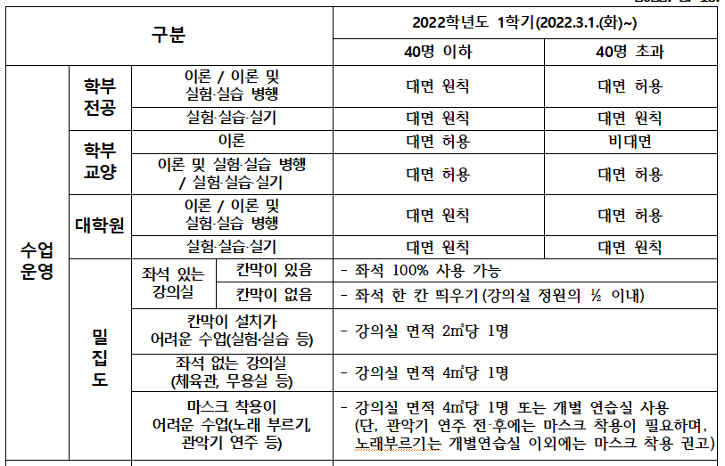
대면/비대면 수업 진행에 대한 논의

Slide 4
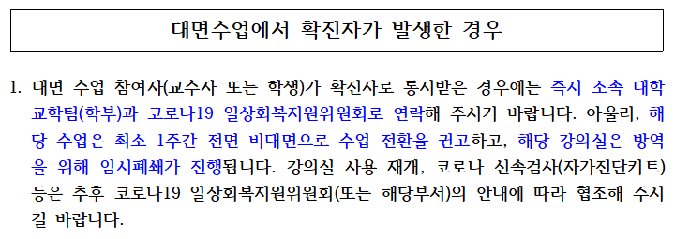
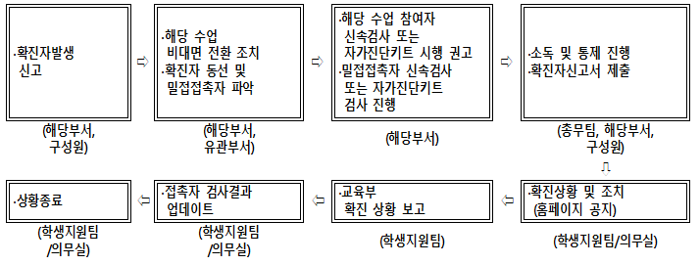
대면/비대면 수업 진행에 대한 논의

Slide 5
온라인 수업 진행 시
수업 진행
해당 주차 진도의 유튜브 영상 미리 시청
채널 - https://www.youtube.com/김남규
재생목록 – 30_데이터과학개론(2022)
https://youtube.com/playlist?list=PLg_wJlcMiuKsJZ7d4VTzijGeEdUd5YaOL
재생목록 - 99_데이터과학개론(2021)
https://youtube.com/playlist?list=PLg_wJlcMiuKt600DRAVTyxmkWigVNKmjB
격주로 Zoom을 통한 온라인 미팅 (19시부터, 약 30분 ~ 1시간)
반드시 캠을 켜야 함 (마스크 착용 가능, 가상배경 사용 가능), 한글 실명으로 접속
수업 내용 간략 Review 및 Q&A
Quiz → 출석 및 Quiz 점수에 반영

Slide 6
온라인 수업 진행 시
화상 수업 참여
매주 수업 시간에 Zoom 회의실 접속
(방식 1) https://kookmin.zoom.us/my/ngkim?pwd=VjQ3bGlFQXVTaWxGRDZ4TVQ5bWRoZz09
(방식 2) https://kookmin.zoom.us/my/ngkim (PW = kmu)
(방식 3) 회의 ID: 8229105425 / 회의 PW: kmu
수업 중 질문은 채팅 또는 음성으로 받음
환경 설정
참가자 이름 설정
참가자 이름을 한글 실명으로 설정: 홍길동(O), 길동홍(X)
화면 하단 [참가자 관리] 클릭 → 본인 이름 우측에서 [더 보기] 클릭 → [이름 바꾸기]
마이크, 스피커, 카메라 동작 확인 → 음소거 / 음소거 해제 연습
화면 하단 [채팅] 클릭 → 질문 남기기 연습

Slide 7
Topics to be covered
Week | Topic | Week | Topic
01 (3/8) | (Z) Course Orientation | 09 (5/3) | Neural Network
02 (3/15) | Data Science Overview & Data Preprocessing | 10 (5/10) | (Z) Neural Network (cont’d)
03 (3/22) | (Z) Association | 11 (5/17) | Assessment
04 (3/29) | Clustering | 12 (5/24) | (Z) Text Analytics
05 (4/5) | (Z) Clustering (cont’d) | 13 (5/31) | Text Analytics (cont’d)
06 (4/12) | Classification | 14 (6/7) | (Z) Text Analytics (cont’d)
07 (4/19) | (Z) Classification (cont’d) | 15 (6/14) | (Z) Final Exam
08 (4/26) | Classification (cont’d)

Slide 8
Topics to be covered
Part | Subject | Contents
1. Data Science Overview | Introduction | DIKW Pyramid
 |  | Big Data Issues
 |  | CRISP-DM Process
 | Inference | Induction / Deduction
 |  | Learning / Inference (Scoring)
 | Related Areas | Data Science Technologies
 | Modeling Concerns | Analytics Types: Descriptive / Diagnostic / Predictive / Prescriptive
 |  | Learning Types: Supervised / Unsupervised
 |  | Knowledge Types: Association / Clustering / Classification
 |  | Classical Machine Learning
 | Variables | Unit of Analysis
 |  | Target Variable
 |  | Input Variable
 | Assessment | Various Measures
 |  | Overfitting
 |  | Baseline

Slide 9
Topics to be covered
Part | Subject | Contents
2. Data Preprocessing | Introduction | Basic Concept
 | Data Cleansing | Data Standardization, Normalization
 |  | Missing Value, Outlier, Five Number Summary, IQR
 |  | Variable Transformation, Variable Generation
 |  | Data Sampling
 | Data Summarization | Expectation, Mean(Arithmetic, Geometric, Harmonic)
 |  | Average, Weighted Average
 |  | Median, Mode
 |  | Variance, Standard Deviation
3. Association | Introduction | Basic Concept
 |  | Major Issues
 | Interestingness Measures | Confidence, Support, Lift
 |  | PMI, PPMI
 | Apriori Algorithm | Apriori Algorithm

Slide 10
Topics to be covered
Part | Subject | Contents
4. Clustering | Introduction | Motivating Example
 |  | Conceptualization
 |  | Basic Concept
 | Matrix in Clustering | Data Matrix
 |  | Distance Matrix
 | Distance | Minkowski Distance (Euclidean, Manhattan)
 |  | Jaccard Distance
 |  | Levenshtein Distance
 |  | Cosine Distance
 | Clustering Method | Hierarchical Method - Dendrogram
 |  | Density-based Method - DBSCAN
 |  | Partitioning Method - K-Means
 | Clustering Evaluation | Evaluation Criteria
 |  | Elbow Method, Dunn Index, Calinski-Harabasz Index, Silhouette Index
 | Cluster Profiling | Cluster Profiling

Slide 11
Topics to be covered
Part | Subject | Contents
5. Classification | Introduction | Motivating Example
 |  | Classification / Prediction
 |  | Learning / Inference (Scoring)
 | Overfitting | Generalization / Overfitting
 |  | Training / Validation / Test / Score
 |  | Learning Curve
 |  | Cross Validation (Holdout, k-fold, Leave-p-out, Leave-one-out)
 | Nearest Neighbor (k-NN) | Basic Concept
 |  | Majority Voting / Weighted Voting
 | Decision Tree (Tree Induction) | Basic Concept
 |  | Information Gain, Gini Index, Variance Reduction
 |  | Pruning (Pre-Pruning / Post-Pruning)
 |  | Tree Types (Tree, If~Then Rule, Tree Map, Tree Ring)
 |  | Tree Interpretation (Nominal Target, Interval Target)
 |  | Probability Estimation (Frequency-based Estimation, Laplace Correction)
 |  | Resampling (Highly Imbalanced Data, Undersampling, Oversampling)

Slide 12
Topics to be covered
Part | Subject | Contents
5. Classification (cont’d) | Naïve Bayesian Classifier | Conditional Probability
 |  | Bayes’ Theorem
 |  | Naïve Bayesian Classifier
 | Model Fitting (Parametric Modeling) | Motivating Example
 |  | Decision Boundary
 |  | Optimization
 |  | Object Function
 | Linear Regression | Basic Concept
 |  | Least Squared Method
 | Logistic Regression | Basic Concept
 |  | Linear Classifier
 |  | Odds Function, Logistic Function (Sigmoid)
 | SVM | Motivating Example
 |  | Margin
 |  | Kernel Function
 |  | Soft Margin SVM
 |  | Hinge Loss

Slide 13
Topics to be covered
Part | Subject | Contents
6. Neural Network | Introduction | Vector, Matrix, Array
 | Matrix Operation | Numpy, Arithmetic Operation, Dot Product & Matrix Multiplication, Aggregation, Transpose, Broadcast
 | Perceptron | Basic Concept
 |  | Logic Gate Implementation
 |  | Multi-layer Perceptron
 | Neural Network Architecture | NN Components
 |  | NN Procedure
 | Forward Induction | Affine Transformation
 |  | Activating Function
 |  | Softmax Function
 |  | Loss Function, Cross Entropy Error

Slide 14
Topics to be covered
Part | Subject | Contents
6. Neural Network (cont’d) | Differential | Differential, Partial Differential
 | Backpropagation | Chain Rule, Optimizer
 | Hyperparameters | Mini batch, Epoch
7. Assessment | Introduction | Accuracy vs. Coverage
 |  | Baseline (Majority Voting, Decision Stump)
 | Measures | Misclassification Rate / Mean Squared Error
 |  | Confusion Matrix (False Positive, False Negative)
 |  | F₁ Score (Precision, Recall)
 |  | ROC (Sensitivity, Specificity), AUC
 |  | Lift Chart (Response, Captured Response, Lift)

Slide 15
Topics to be covered
Part | Subject | Contents
8. Text Analytics | Introduction | Big Data Issues
 |  | Text Mining vs. Data Mining
 |  | Why Text?
 |  | Text Mining Techniques
 |  | Basic Applications
 |  | Related Areas
 |  | Text Mining Modules in Python
 | Input Files | Binary Text & Plain Text
 |  | Text Encoding
 |  | File Types (Structured / Unstructured / Semi-Structured)
 |  | Web Crawling
 | POS Tagging | Part of Speech
 |  | Morpheme
 |  | Language Types
 |  | POS Tagging in Text Analytic

Slide 16
Topics to be covered
Part | Subject | Contents
8. Text Analytics (cont’d) | Word Representation | Basic Concept
 | Thesaurus-based Approach | Thesaurus
 |  | WordNet
 | Statistics-based Approach | Basic Concept
 |  | Distributional Representation
 |  | Co-occurrence Matrix
 |  | Vector Space Model (Doc./Term Matrix)
 |  | TF-IDF
 | Word Similarity | Basic Concept
 |  | Cosine Similarity (Part 4 - Clustering 참고)
 |  | PMI (Part 3 - Association 참고)
 | Dimension Reduction | Basic Concept
 |  | SVD

Slide 17
Topics to be covered
Part | Subject | Contents
8. Text Analytics (cont’d) | Visualization | Word Cloud
 | Word2vec | Basic Concept
 |  | One-Hot Encoding
 |  | CBOW / Skip-gram
 |  | Word Similarity
 |  | Analogy
 |  | Visualizing Word Vector (Simulation, t-SNE)
 |  | Document Embedding (Doc2vec)
 | Topic Modeling | Basic Concept
 |  | LSA
 |  | LDA
 |  | Topic Visualization
 |  | Topic Evaluation

